Slide 1




Demo of BI Portal for Psyon
Proof of Concept

Slide 2

Agenda
Demo of POC showing feasibility of embedding Power BI in portal
Demos of BI applications (Accelerator Portal and Howden UK Dashboard) implemented by Pramati
A view on technology stack and architecture for the portal

Slide 3

Features of the POC Portal
Embedded Power BI dashboards in Portal
Single Sign-on(SSO) based on Azure’s AD authentication
Row level data security based on user hierarchy
Dynamic dashboard menu based on user permissions

Slide 4








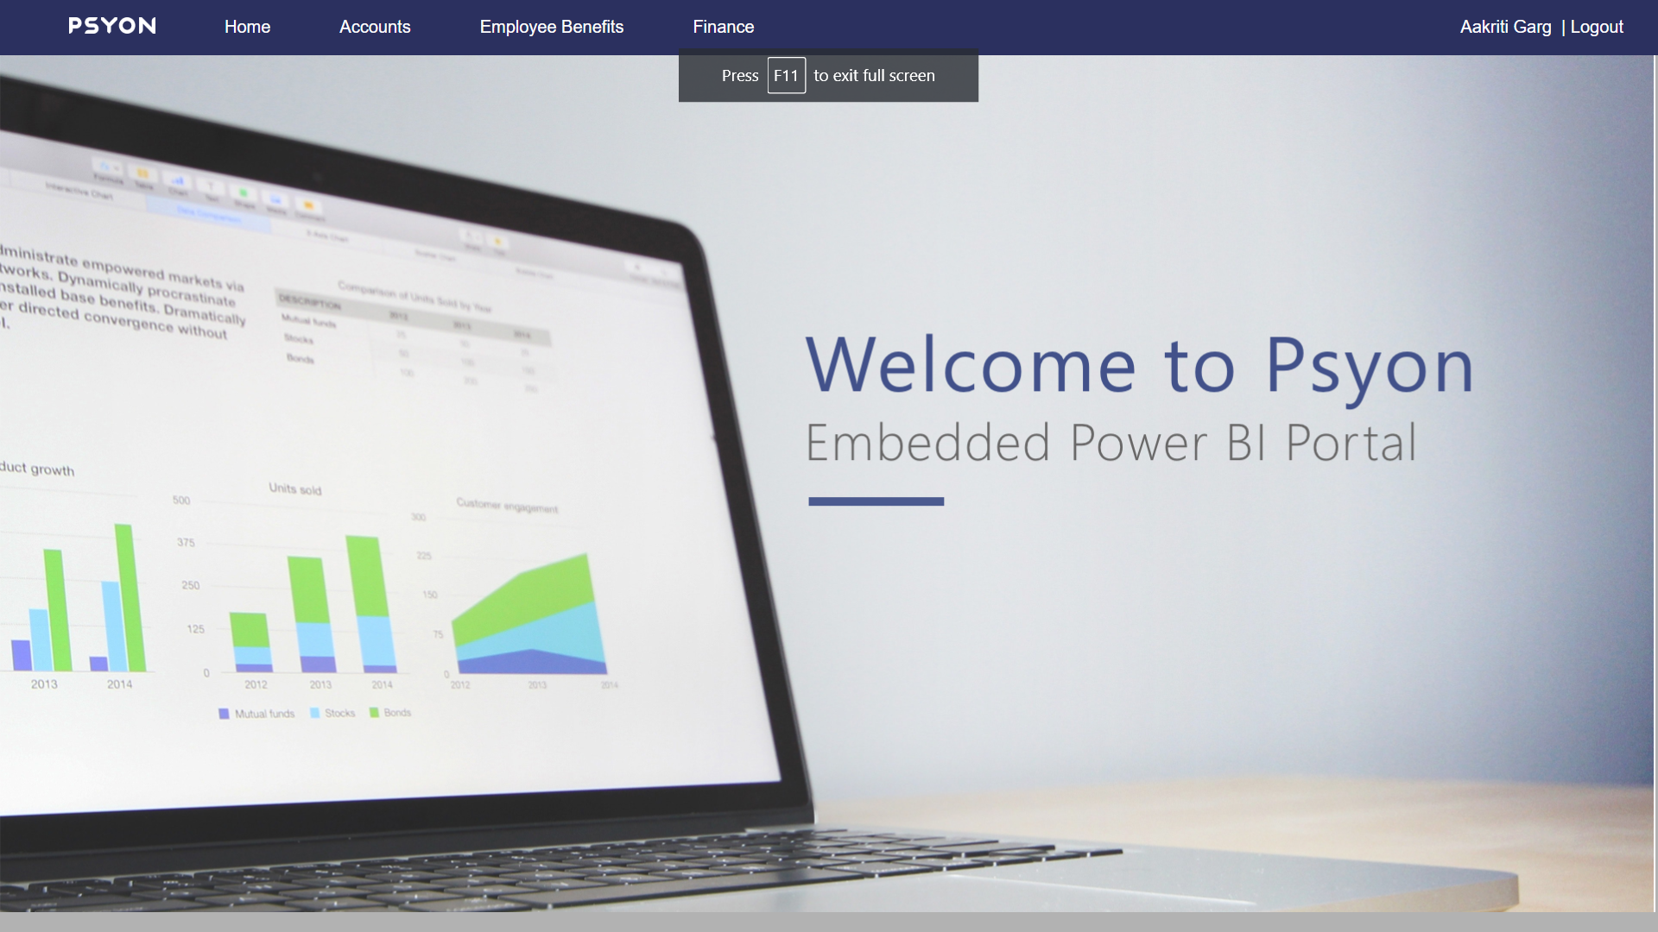



Application Architecture
Data Layer
API Layer/Azure
UI
SQL Server
Power BI
CI & CD
App Service Plan
Dashboards
Azure Resource group
Tabular Cube
Reports
Datasets
RLS
Sources Systems
Technology stack : ASP.NET MVC, C#.NET, Azure AD, Azure App Service, Azure DevOps, Application Insights, Power BI Cloud

Slide 5

Applications Demo
Psyon POC Portal : https://psyon-power-bi-portal.azurewebsites.net
Accelerator Portal URL: https://accelerator.hyperiongrp.com
Howden UK URL : https://accelerator.hukdashboards.hyperiongrp.com/login

Slide 6


Slide 7
POC - Screenshots

Slide 8
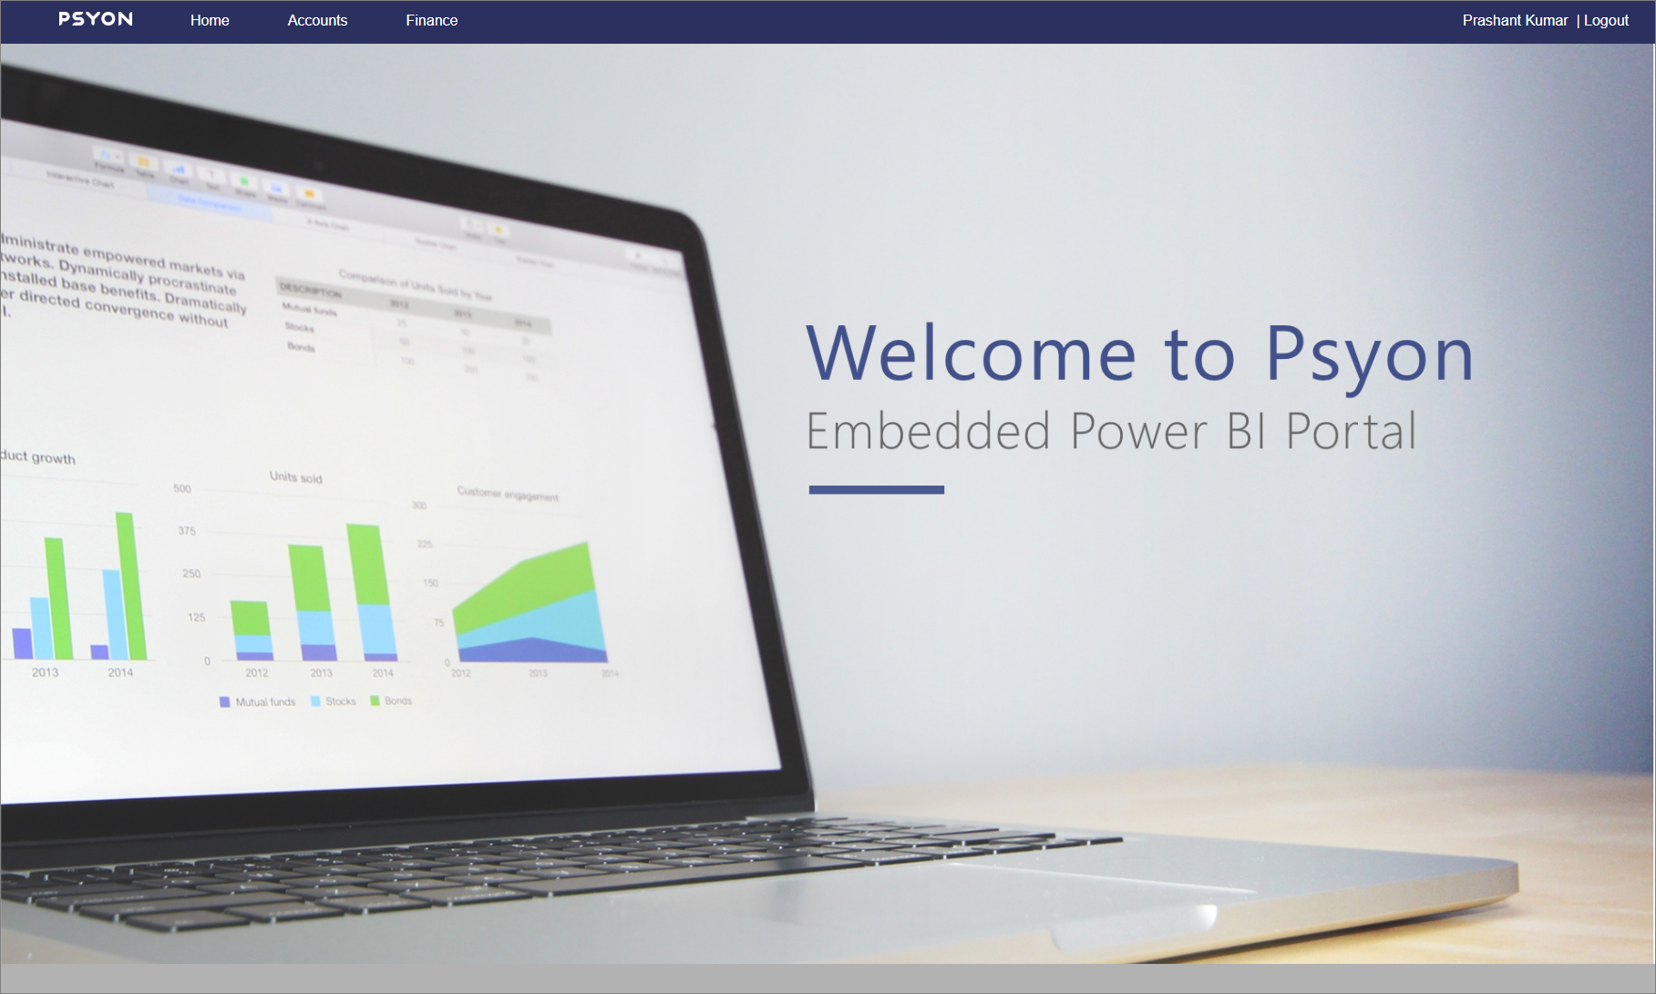
Home Page

Slide 9
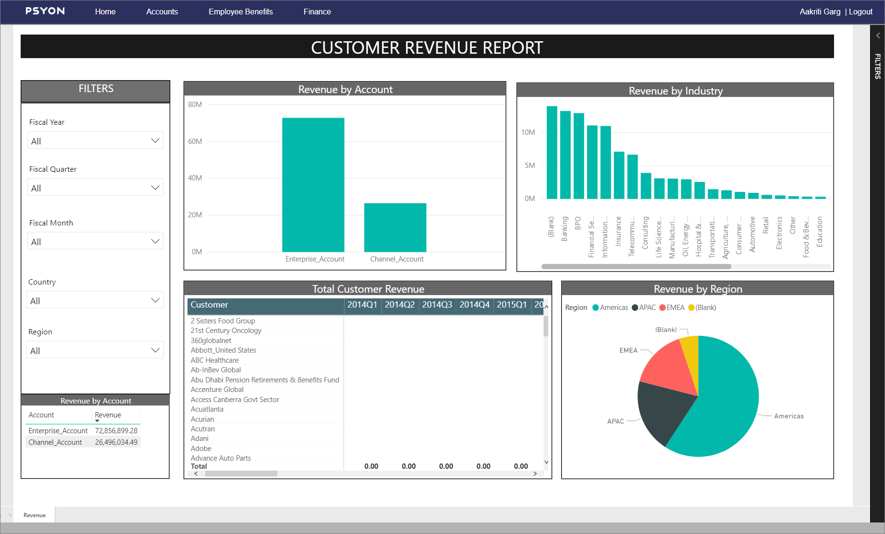
User1

Slide 10

User2

